Slide 1
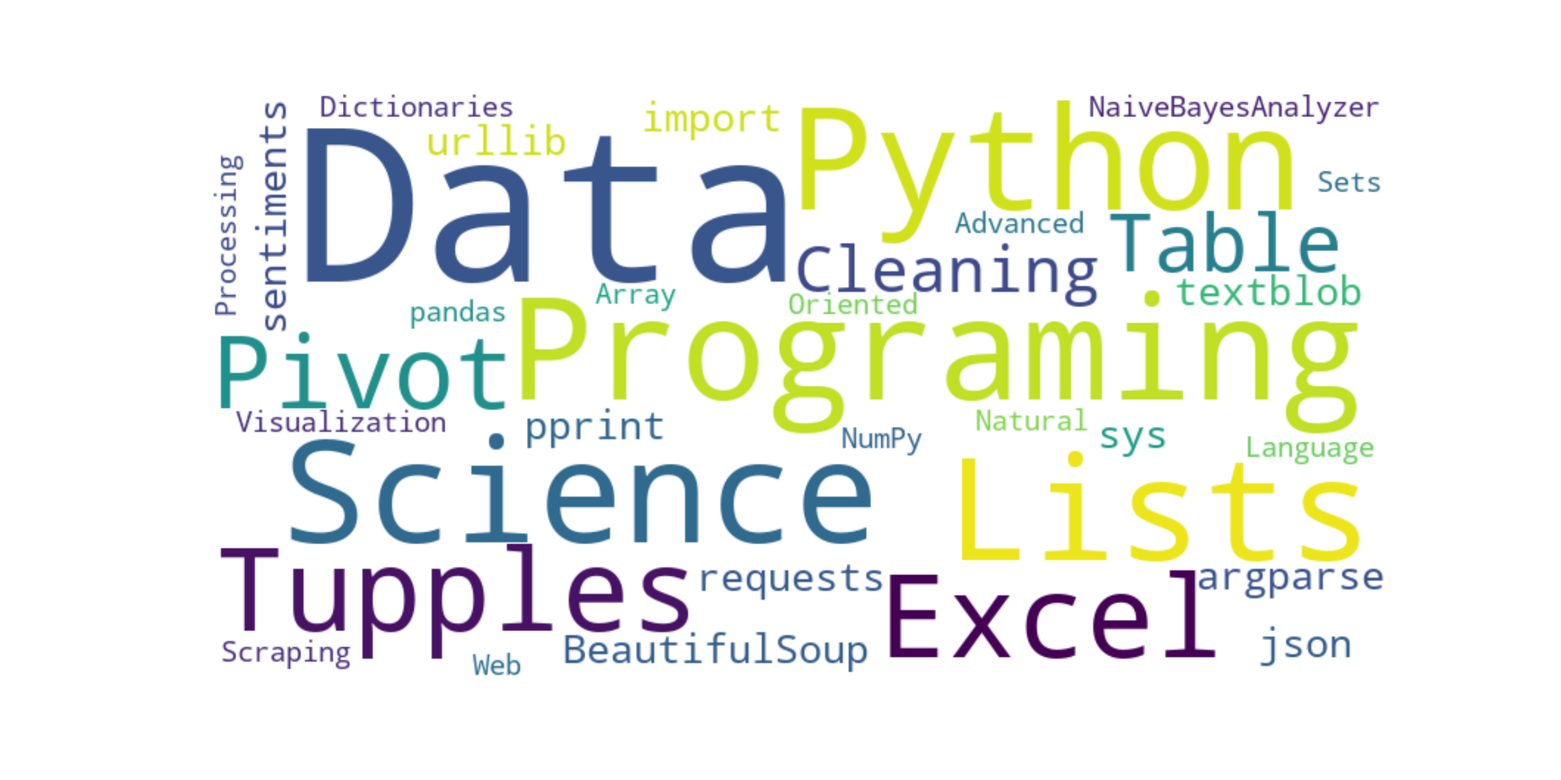

Final Project
Financial Markets - Technical Analysis
Data Science Programming (CMP-262-26528)
Professor N. Binowski
County College of Morris
Spring 2023
Kevin J. Schwint
May 9, 2023

Slide 2


Agenda
Introduction
Methodology
Results
Future Work
Appendix

Slide 3
Introduction
Fundamental Analysis - attempts to evaluate a security's value based on business results such as sales and earnings
Past performance is not indicative of future results
Technical Analysis - a trading discipline employed to evaluate investments and identify trading opportunities by analyzing statistical trends gathered from trading activity, such as price movement and volume
Past performance is not indicative of future results
Past performance is indicative of future results
Can Technical Analysis be an effective way of selecting stocks?

Slide 4
Methodology
Obtaining the Data
Web Scraping Financial web sites
Downloading data from Financial web sites themselves
Downloading data from Python Library of Yahoo Data
Plotting the Data
Stock Price and Volume
Candlestick Plots
Moving Averages
Processing the Data to obtain Useful Information
Statistical Correlations
Sentiment Indicators
Drawing Conclusions from the Results

Slide 5
Financial Data - web scraping
Yahoo Finance http://www.finance.yahoo.com/
Google Finance https://www.google.com/finance/
Bloomberg
CNNMoney
Morningstar
TMXMoney
XE: Foreign Exchange http://www.xe.com/
Kitco: Precious Metals http://www.kitco.com/
Yahoo Finance API No longer supported
import yfinance as yf Install yfinance library by running pip install yfinance

Slide 6
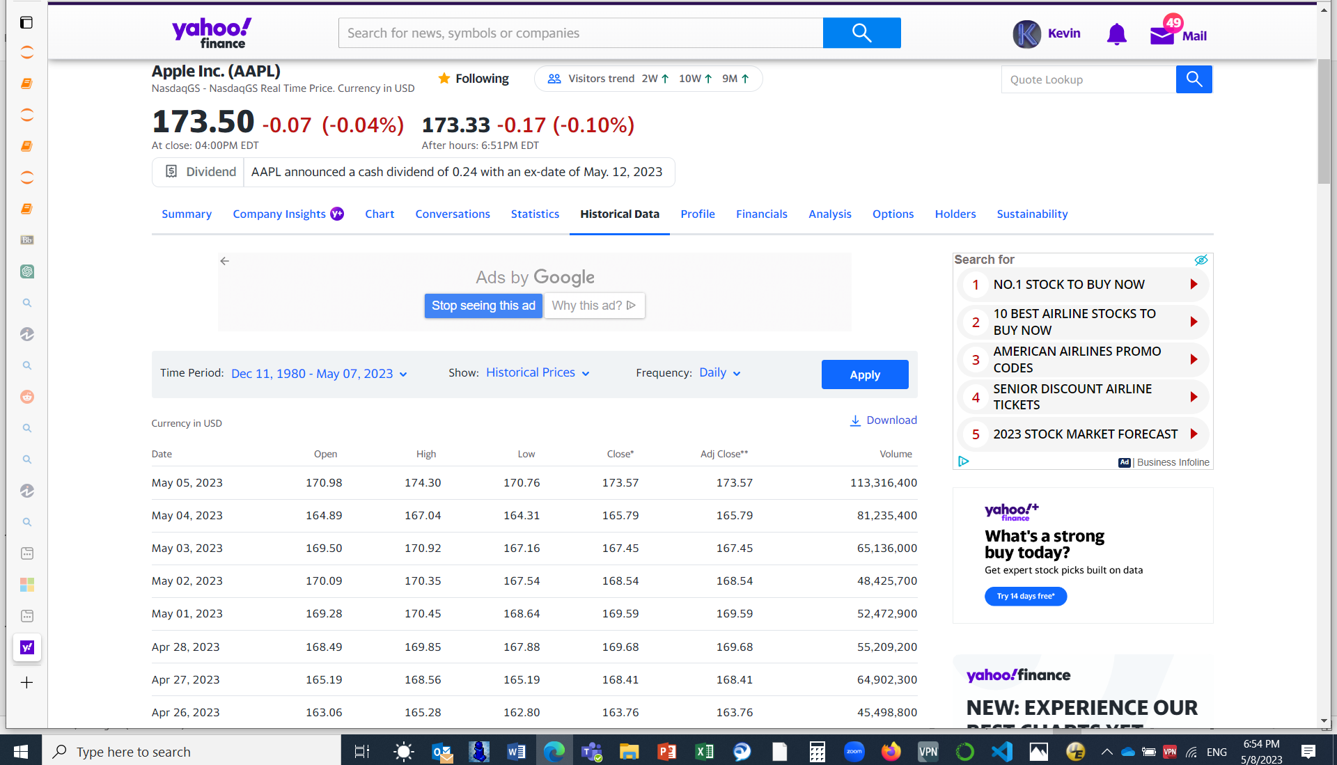
Yahoo Finance Historical Data – download .csv

Slide 7
Python yfinance Library – data download
import yfinance as yf
import pandas as pd
def scrape_data(symbols):
data = {}
for symbol in symbols:
stock_data = yf.download(symbol, period="max") # Fetch all available historical data
data[symbol] = stock_data
filename = f"{symbol}_data.csv"
stock_data.to_csv(filename) # Write the data to a CSV file
print(f"Data for {symbol} saved to {filename}")
return data
# Example usage: scrape data for AAPL, IBM, GM, and GE
symbols = ["^TNX", "AAPL", "BRK-B", "DOW", "IBM", "GE", "MO", "GLD", "SLV"]
data = scrape_data(symbols)
# Print the DataFrame for each symbol
for symbol, df in data.items():
print(f"Data for {symbol}:")
print(df)

Slide 8
Historical Stock Data - Excel .xlsv
AAPL - Apple Sock

Slide 9
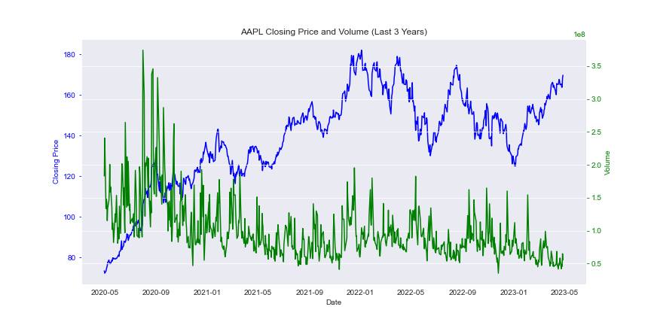
AAPL Closing Price and Volume (last 3 years)

Slide 10
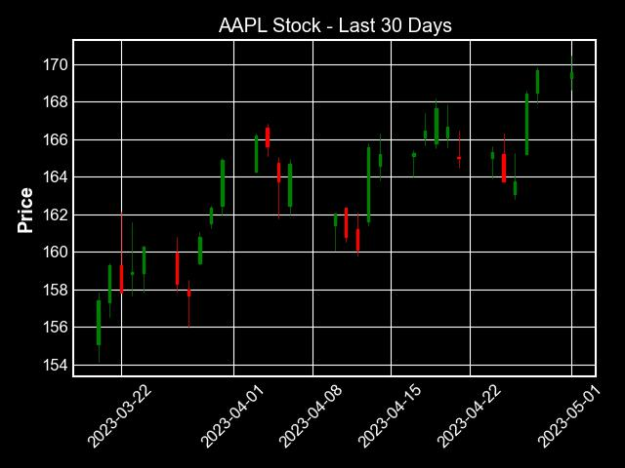
Candlestick Chart

Slide 11
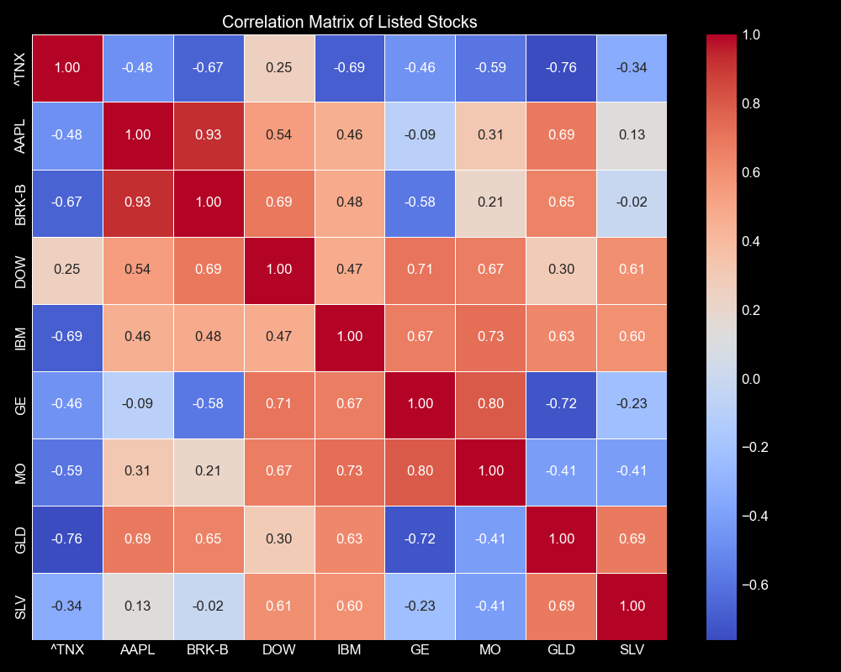
Correlation Matrix
Legend
^TNX 10 year Treasury Bond
AAPL Apple Stock
BRK-B Bershire Stock – Class B
DOW Dow Chemical Stock
IBM IBM Stock
GE GE Stock
MO Altria Group Inc. Stock
GLD SPDR Gold Shares ETF
SLV iShares Silver Trust ETF

Slide 12
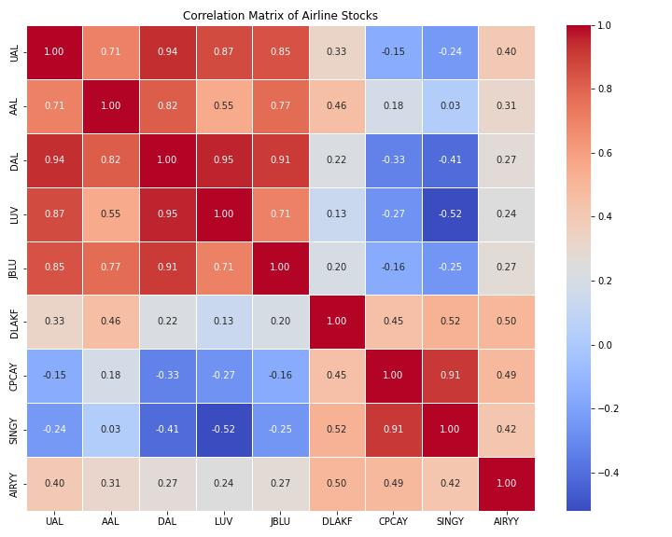
Diversified Portfolio?
Airline Stocks
UAL United Airlines
AAL American Airlines
DAL Delta Airlines
LUV Southwest Airlines
JBLU Jet Blue Airlines
DLAKF Lufthansa
CPCAY Cathay Pacific
SINGY Singapore Airlines
AIRYY Air China

Slide 13
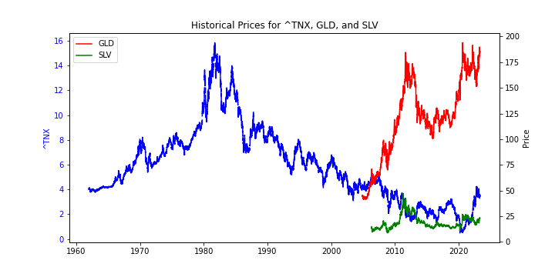
GLD and SLV Against ^TNX

Slide 14
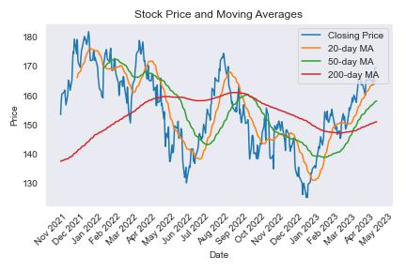
AAPL Stock Price and Moving Averages

Slide 15
Stock Sentiment and Subjectivity Analysis
AAPL Apple Stock
Headline: 1 FAANG Stock to Buy Hand Over Fist in May and 1 to Avoid Like the Plague Description: The Motley Fool · 16 hours ago
Polarity: 0.6 Subjectivity: 0.9
Headline: India: What the smartphone market tells us about its economy Description: A busy week of earnings season and lots of news developments have us revising some of the price targets and ratings on the stocks in the...1 day ago
Polarity: 0.1 Subjectivity: 0.3
Headline: Apple, Sitting on $57B Cash, Plans Bond Sale Yielding More Than Treasurys Description: A busy week of earnings season and lots of news developments have us revising some of the price targets and ratings on the stocks in the...1 day ago
Polarity: 0.1 Subjectivity: 0.3
Overall Polarity: 0.0444
Overall Subjectivity: 0.1278

Slide 16
Results
AAPL – Buy, Hold or Sell?
Trend is up / Volume is low but fairly steady Candelstick pattern is Trend Continuation
Negative Correlation with Interest Rates Have Interest Rates peaked? Heading down?
Stock Price is above the 20-day, 50-day and 200-day Moving Averages
Sentiment is very low (barely positive) Can be a Reverse Indicator or High Degree of Uncertainty?

Slide 17
Future Work
Identify which other stocks are correlated with AAPL (positively or negatively)
See if correlation can be maximized by shifting AAPL against that stock (e.g. 14 day lead/lag)
Automate the process so that the program will automatically screen many stocks and determine maximum correlation at an optimum lead time
Develop better quantitative parameters
Use this as a “Buy” signal or “Sell” signal based on the action of the other stock

Slide 18
Appendix

Slide 19
Word Cloud - code
from wordcloud import WordCloud
import matplotlib.pyplot as plt
# List of words
words = ["Data Science Programing", "Python", "Lists", "Tupples", "Excel",
"Pivot Table", "Data Cleaning", "BeautifulSoup", "argparse", "json",
"pprint", "requests", "sys", "urllib", "textblob", "sentiments", "import",
"NaiveBayesAnalyzer", "pandas", "Dictionaries", "Sets", "NumPy",
"Array Oriented", "Advanced Data Visualization", "Web Scraping",
"Natural Language Processing"]
# Convert the list of words to a string
text = ' '.join(words)
# Generate the word cloud
wordcloud = WordCloud(width=800, height=400, background_color='white').generate(text)
# Plot the word cloud
plt.figure(figsize=(10, 5))
plt.imshow(wordcloud, interpolation='bilinear')
plt.axis('off')
# Save the word cloud to a file
plt.savefig('wordcloud.png', dpi=300)
# Adjust the file name and DPI as needed
# Show the word cloud
plt.show()

Slide 20
Yahoo Finance Historical Data – web scraping
import requests
from bs4 import BeautifulSoup
import pandas as pd
def scrape_yahoo_finance_history(symbol):
url = f"https://finance.yahoo.com/quote/{symbol}/history"
response = requests.get(url)
soup = BeautifulSoup(response.content, "html.parser")
table = soup.find_all("table", class_="W(100%) M(0)")[0] # Updated table class
rows = table.tbody.find_all("tr")
data = []
for row in rows:
cells = row.find_all("td")
if len(cells) == 7:
date = cells[0].span.text.strip()
open_price = cells[1].span.text.strip()
high_price = cells[2].span.text.strip()
low_price = cells[3].span.text.strip()
close_price = cells[4].span.text.strip()
adj_close_price = cells[5].span.text.strip()
volume = cells[6].span.text.strip()
data.append((date, open_price, high_price, low_price, close_price, adj_close_price, volume))
return data
def scrape_data(symbols):
data = {}
for symbol in symbols:
data[symbol] = scrape_yahoo_finance_history(symbol)
return data
# Example usage: scrape data for AAPL, IBM, GM, and GE
symbols = ["^TNX", "AAPL", "BRK-B", "DOW", "IBM", "GE", "MO", "GLD", "SLV"]
data = scrape_data(symbols)
# Convert the data to a pandas DataFrame
df = pd.DataFrame.from_dict(data, orient='index',
columns=['Date', 'Open', 'High', 'Low', 'Close', 'Adj Close', 'Volume'])
df.index.name = 'Symbol'
# Print the DataFrame
print(df)

Slide 21
Historical Stock Data – read .csv / write .xlsv
import pandas as pd
def read_datafile(symbol):
datafile = f"{symbol}.csv" # Use the input symbol as the filename
df = pd.read_csv(datafile)
return df # Return the DataFrame
# Example usage: scrape data for AAPL for the past year
symbol = "AAPL"
data_AAPL = read_datafile(symbol)
print(symbol)
print(data_AAPL) # Print the DataFrame
# Save the DataFrame to a CSV file
data_AAPL.to_csv("data_AAPL.csv", index=False)
# Set index=False to exclude the index column
# Save the DataFrame to an Excel file (optional)
data_AAPL.to_excel("data_AAPL.xlsx", index=False)
# Set index=False to exclude the index column

Slide 22
AAPL Closing Price and Volume (last 3 years) - code
import pandas as pd
import yfinance as yf
import matplotlib.pyplot as plt
# Set the ticker symbol and start/end dates
ticker = "AAPL"
start_date = "2020-04-30"
end_date = "2023-04-30"
# Fetch the historical data from Yahoo Finance
data = yf.download(ticker, start=start_date, end=end_date)
# Extract the closing price and volume data
closing_price = data["Close"]
volume = data["Volume"]
# Create a figure with two subplots
fig, ax1 = plt.subplots(figsize=(12, 6))
# Plot the closing price on the left y-axis
ax1.plot(closing_price, color="blue")
ax1.set_xlabel("Date")
ax1.set_ylabel("Closing Price", color="blue")
ax1.tick_params("y", colors="blue")
# Create a twin y-axis for volume
ax2 = ax1.twinx()
# Plot the volume on the right y-axis
ax2.plot(volume, color="green")
ax2.set_ylabel("Volume", color="green")
ax2.tick_params("y", colors="green")
# Set the title
plt.title("AAPL Closing Price and Volume (Last 3 Years)")
plt.grid(True)
# Save the plot to a PNG file
plt.savefig("closing_price_volume.png")
# Save the plot to a JPEG file
plt.savefig("closing_price_volume.jpeg", format='jpeg')
# Write the results to a CSV file
output_filename = "closing_price_volume.csv"
result_df = pd.concat([closing_price, volume], axis=1)
result_df.columns = ["Closing Price", "Volume"]
result_df.to_csv(output_filename, index=True)
print(f"Results saved to {output_filename}")
# Show the plot
plt.show()

Slide 23
Candlestick Charts - code
import matplotlib.pyplot as plt
from mplfinance.original_flavor import candlestick_ohlc
import pandas as pd
import matplotlib.dates as mpdates
# List of symbols to plot
symbols = ["^TNX", "AAPL", "BRK-B", "DOW", "IBM", "GE", "MO", "GLD", "SLV"]
# Iterate over each symbol
for symbol in symbols:
# Read the data from the CSV file
datafile = f"{symbol}.csv"
df = pd.read_csv(datafile, parse_dates=True, index_col=0)
# Slice the data for the last 30 days
last_30_days = df.tail(30).copy()
# Create a new figure and axis for the plot
fig, ax = plt.subplots()
# Convert the date index to a numerical format compatible with candlestick_ohlc
last_30_days['Date'] = last_30_days.index.map(mpdates.date2num)
# Iterate over the data and plot each candlestick
for i, row in last_30_days.iterrows():
open_price = row['Open']
high = row['High']
low = row['Low']
close = row['Close']
color = 'green' if close >= open_price else 'red'
candlestick_ohlc(ax, [[row['Date'], open_price, high, low, close]], colorup='green', colordown='red')
# Set the x-axis tick labels
ax.xaxis.set_major_formatter(mpdates.DateFormatter('%Y-%m-%d'))
ax.xaxis.set_major_locator(mpdates.AutoDateLocator())
# Set the plot title and labels
ax.set_title(f"{symbol} Stock - Last 30 Days")
ax.set_ylabel('Price')
# Rotate the x-axis labels for better readability
plt.xticks(rotation=45)
# Save the plot to a PNG file
plt.tight_layout()
plt.savefig(f"{symbol}_candlestick.png")
# Save the plot to a JPEG file
plt.savefig(f"{symbol}_candlestick.jpeg", format='jpeg')
# Show the plot
plt.tight_layout()
plt.show()
# Close the plot
plt.close()

Slide 24
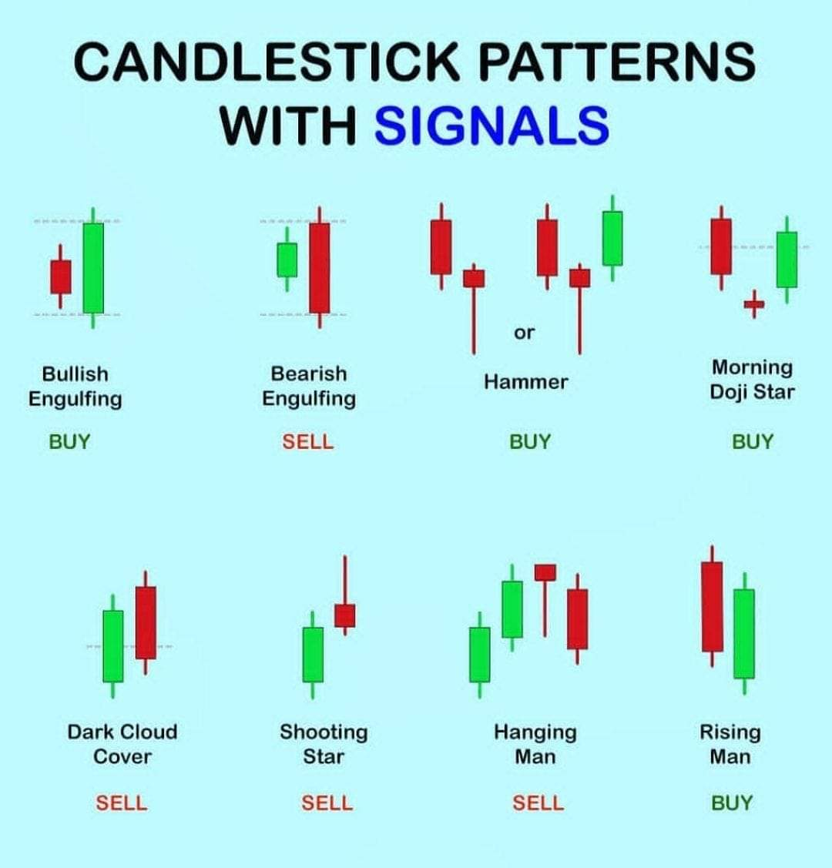
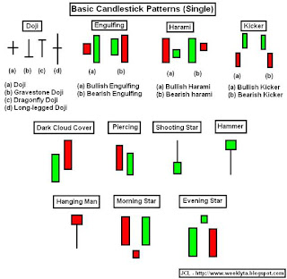
Candlestick Patterns

Slide 25
Correlation Matrix - code
import pandas as pd
import seaborn as sns
import matplotlib.pyplot as plt
# List of symbols
symbols = ["^TNX", "AAPL", "BRK-B", "DOW", "IBM", "GE", "MO", "GLD", "SLV"]
# Fetch the stock data and create a DataFrame
dfs = {}
for symbol in symbols:
dfs[symbol] = pd.read_csv(f"{symbol}.csv", parse_dates=True, Index_col=0)
# Combine the closing prices into a single DataFrame
df_close = pd.concat([df['Close'] for df in dfs.values()], axis=1)
df_close.columns = symbols
# Compute the correlation matrix
corr_matrix = df_close.corr()
# Plot the correlation matrix
plt.figure(figsize=(10, 8))
sns.heatmap(corr_matrix, annot=True, cmap='coolwarm', fmt=".2f", linewidths=0.5)
plt.title("Correlation Matrix of Listed Stocks")
# Save the plot to a PNG file
plt.tight_layout()
plt.savefig(f"corr_matrix.png")
# Save the plot to a JPEG file
plt.savefig(f"corr_matrix.jpeg", format='jpeg')
plt.show()

Slide 26
AAPL Stock Price and Moving Averages - code
import pandas as pd
import matplotlib.pyplot as plt
import matplotlib.dates as mdates
# Read the data from the CSV file
datafile = 'AAPL.csv'
df = pd.read_csv(datafile, parse_dates=True, index_col=0)
# Slice the data for the past 52 weeks
past_52_weeks = df.tail(52 * 7)
# Calculate the moving averages
ma_20 = past_52_weeks['Close'].rolling(window=20).mean()
ma_50 = past_52_weeks['Close'].rolling(window=50).mean()
ma_200 = df['Close'].rolling(window=200).mean()
# Filter the 200-day moving average for the past 52 weeks
ma_200_52_weeks = ma_200.tail(52 * 7)
# Create a new figure and axis for the plot
fig, ax = plt.subplots()
# Plot the closing price
ax.plot(past_52_weeks.index, past_52_weeks['Close'], label='Closing Price')
# Plot the moving averages
ax.plot(past_52_weeks.index, ma_20, label='20-day MA')
ax.plot(past_52_weeks.index, ma_50, label='50-day MA')
ax.plot(ma_200_52_weeks.index, ma_200_52_weeks, label='200-day MA')
# Set the plot title and labels
ax.set_title('Stock Price and Moving Averages')
ax.set_xlabel('Date')
ax.set_ylabel('Price')
# Rotate x-axis tick labels for better readability
plt.xticks(rotation=45)
# Set the x-axis ticker to display ticks at monthly intervals
ax.xaxis.set_major_locator(mdates.MonthLocator())
# Format the x-axis tick labels as month-year
ax.xaxis.set_major_formatter(mdates.DateFormatter('%b %Y'))
# Display a legend
ax.legend()
# Save the plot to a PNG file
plt.tight_layout()
plt.savefig("stock_price_MA.png")
# Save the plot to a JPEG file
plt.savefig("stock_price_MA.jpeg", format='jpeg')
# Show the plot
plt.tight_layout()
plt.show()

Slide 27
Stock Sentiment and Subjectivity Analysis - code
import requests
from bs4 import BeautifulSoup
from textblob import TextBlob
# Define the search query and URL
query = "AAPL"
url = f"https://www.google.com/search?q={query}&tbm=nws"
# Send a GET request to the URL
response = requests.get(url)
# Parse the HTML content using BeautifulSoup
soup = BeautifulSoup(response.content, "html.parser")
# Find the news article headlines and descriptions
headlines = soup.find_all("h3", class_="zBAuLc")
descriptions = soup.find_all("div", class_="BNeawe s3v9rd AP7Wnd")
# Lists to store polarity and subjectivity scores for each article
polarities = []
subjectivities = []
# Extract the text from the headlines and descriptions
articles = []
for headline, description in zip(headlines, descriptions):
articles.append({
"headline": headline.get_text(),
"description": description.get_text()
})
# Perform sentiment analysis using TextBlob
blob = TextBlob(description.get_text())
polarity = blob.sentiment.polarity
subjectivity = blob.sentiment.subjectivity
# Append polarity and subjectivity scores to the lists
polarities.append(polarity)
subjectivities.append(subjectivity)
# Calculate the overall sentiment
overall_polarity = sum(polarities) / len(polarities)
overall_subjectivity = sum(subjectivities) / len(subjectivities)
# Print the results for each article
for i, article in enumerate(articles):
headline = article["headline"]
description = article["description"]
polarity = polarities[i]
subjectivity = subjectivities[i]
print("Headline:", headline)
print("Description:", description)
print("Polarity:", polarity)
print("Subjectivity:", subjectivity)
print()
# Print the overall sentiment
print("Overall Polarity:", overall_polarity)
print("Overall Subjectivity:", overall_subjectivity)

Slide 28
Stock Sentiment and Subjectivity Analysis - code
import requests
from bs4 import BeautifulSoup
from textblob import TextBlob
# Define the search query and URL
query = "AAPL"
url = f"https://www.google.com/search?q={query}&tbm=nws"
# Send a GET request to the URL
response = requests.get(url)
# Parse the HTML content using BeautifulSoup
soup = BeautifulSoup(response.content, "html.parser")
# Find the news article headlines and descriptions
headlines = soup.find_all("h3", class_="zBAuLc")
descriptions = soup.find_all("div", class_="BNeawe s3v9rd AP7Wnd")
# Lists to store polarity and subjectivity scores for each article
polarities = []
subjectivities = []
# Extract the text from the headlines and descriptions
articles = []
for headline, description in zip(headlines, descriptions):
articles.append({
"headline": headline.get_text(),
"description": description.get_text()
})
# Perform sentiment analysis using TextBlob
blob = TextBlob(description.get_text())
polarity = blob.sentiment.polarity
subjectivity = blob.sentiment.subjectivity
# Append polarity and subjectivity scores to the lists
polarities.append(polarity)
subjectivities.append(subjectivity)
# Calculate the overall sentiment
overall_polarity = sum(polarities) / len(polarities)
overall_subjectivity = sum(subjectivities) / len(subjectivities)
# Print the results for each article
for i, article in enumerate(articles):
headline = article["headline"]
description = article["description"]
polarity = polarities[i]
subjectivity = subjectivities[i]
print("Headline:", headline)
print("Description:", description)
print("Polarity:", polarity)
print("Subjectivity:", subjectivity)
print()
# Print the overall sentiment
print("Overall Polarity:", overall_polarity)
print("Overall Subjectivity:", overall_subjectivity)

Slide 29
References
Technical Indicator: Definition, Analyst Uses, Types and Examples (investopedia.com)
Technical Analysis Blowout: How to Read Candlestick S... - Ticker Tape (tdameritrade.com)
What Is a Momentum Indicator? Definition and Common Indicators (investopedia.com)
7 Technical Indicators to Build a Trading Toolkit (investopedia.com)
Understanding Basic Candlestick Charts (investopedia.com)

